Slide 1
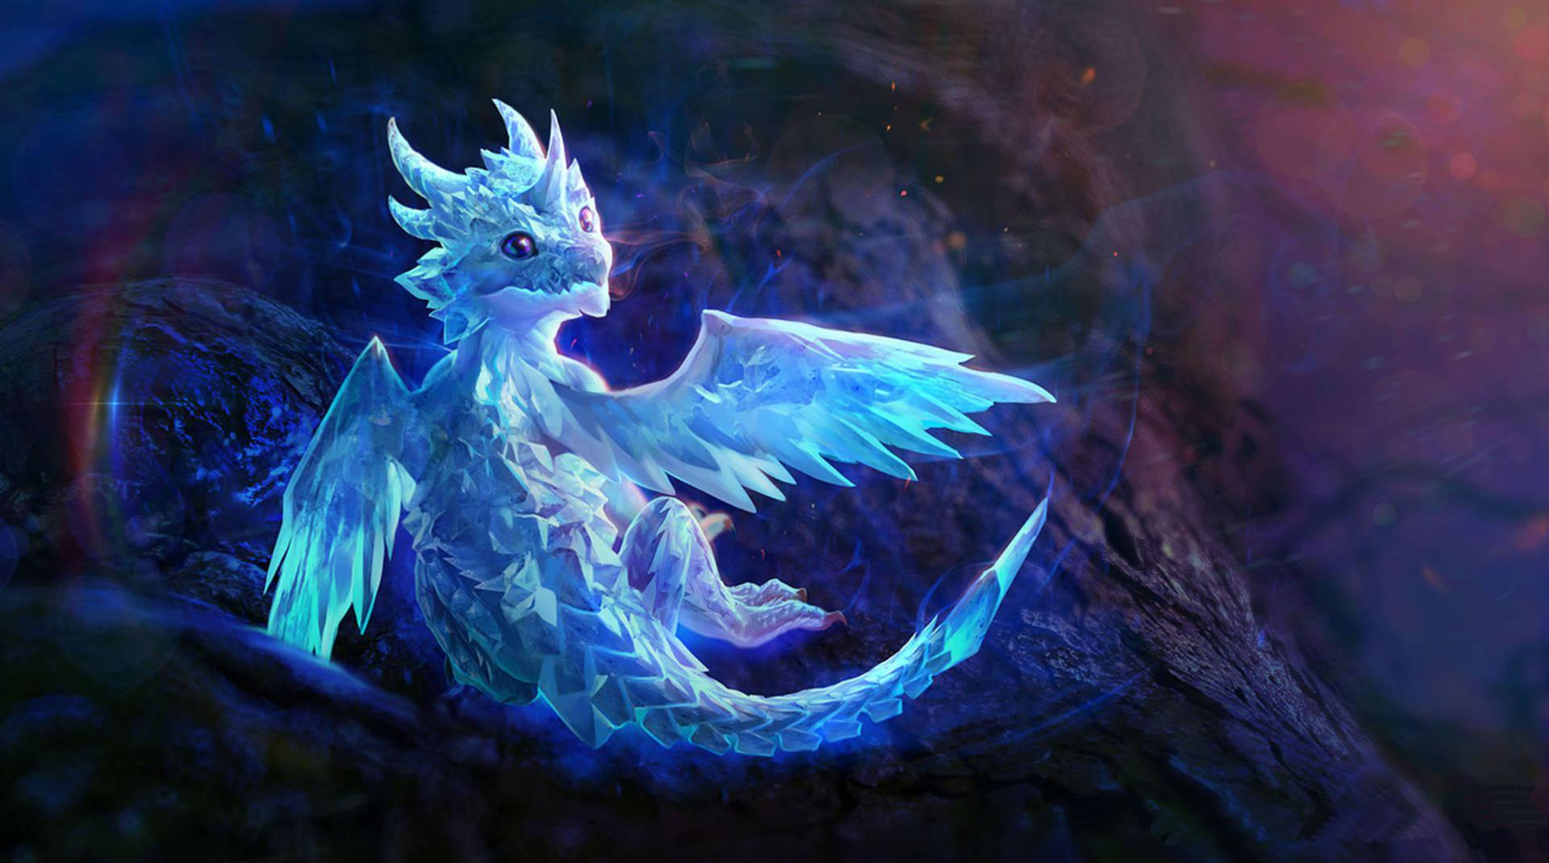

Slide 2
What are Website Does
It has 3 creatures/warriors to choose from
Each creature/warrior has a minigame
Each creature/warrior also has lore(a story)
Each creature/warrior has a photo gallery

Slide 3
“The Teck Stack”

Slide 4
What HTML is
HTML stands for HyperText Markup Language.
Think of it as the skeleton of a webpage. It organizes text, links, and images so your web browser knows how to display them.
How HTML Works
HTML uses tags to label different types of content. Tags are wrapped in angle brackets < >. Most tags have an opening tag and a closing tag to wrap around the content.Common HTML Tags
<h1>: Defines a main heading.
<p>: Defines a text paragraph.
<a>: Defines a hyperlink to another page.
<img>: Displays an image.

Slide 5
GitHub/GitHub Pages
GitHub is a cloud-based platform where developers store, share, and track their software code.
Think of it as Google Docs for programmers, combined with a professional social network. It allows multiple people to work on the same codebase simultaneously without overwriting each other's work.GitHub Pages is a free hosting service that turns your HTML, CSS, and JavaScript files directly into a live website on the internet.
Think of it as the free publishing button for your code. Instead of just sharing raw text files on GitHub, it gives you a real world-wide-web link (like username.github.io) that anyone can visit.

Slide 6
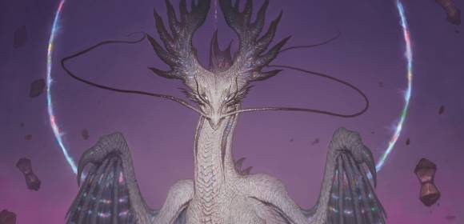
How We Organized Files

Slide 7
Folder structure
We organized our files like this
—-------****** 1
—-------******* 2
—-------********** 3
—-------**** 4

Slide 8
Relative links
Relative links are hyperlinks that point to a file based on its position relative to the current webpage.
Think of them as giving directions from where you are standing right now, rather than using a full GPS address.

Slide 9
Css Magic
CSS is basically how the website looks.If HTML is the skeleton then CSS is the Clothing,Makeup and styling that makes it look appealing.

Slide 10
What CSS is
CSS is basically how the website looks.If HTML is the skeleton then CSS is the Clothing,Makeup and styling that makes it look appealing.

Slide 11
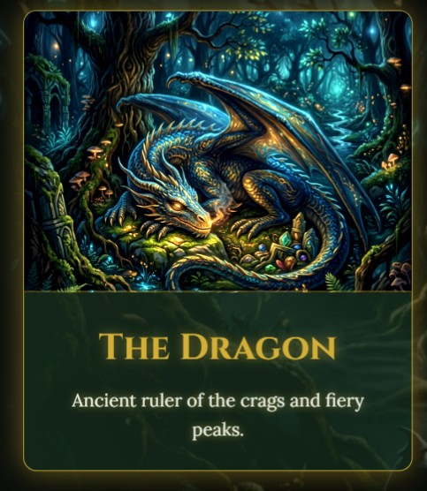

Slide 12
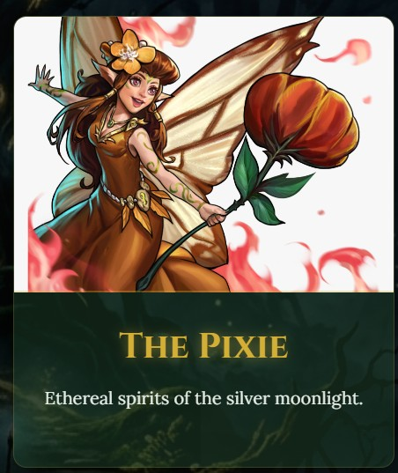

Slide 13
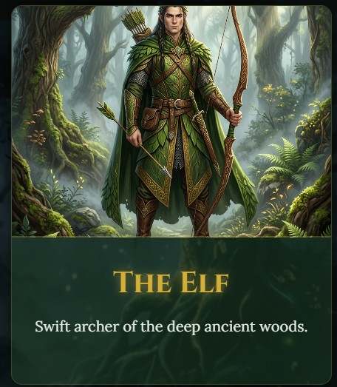

Slide 14
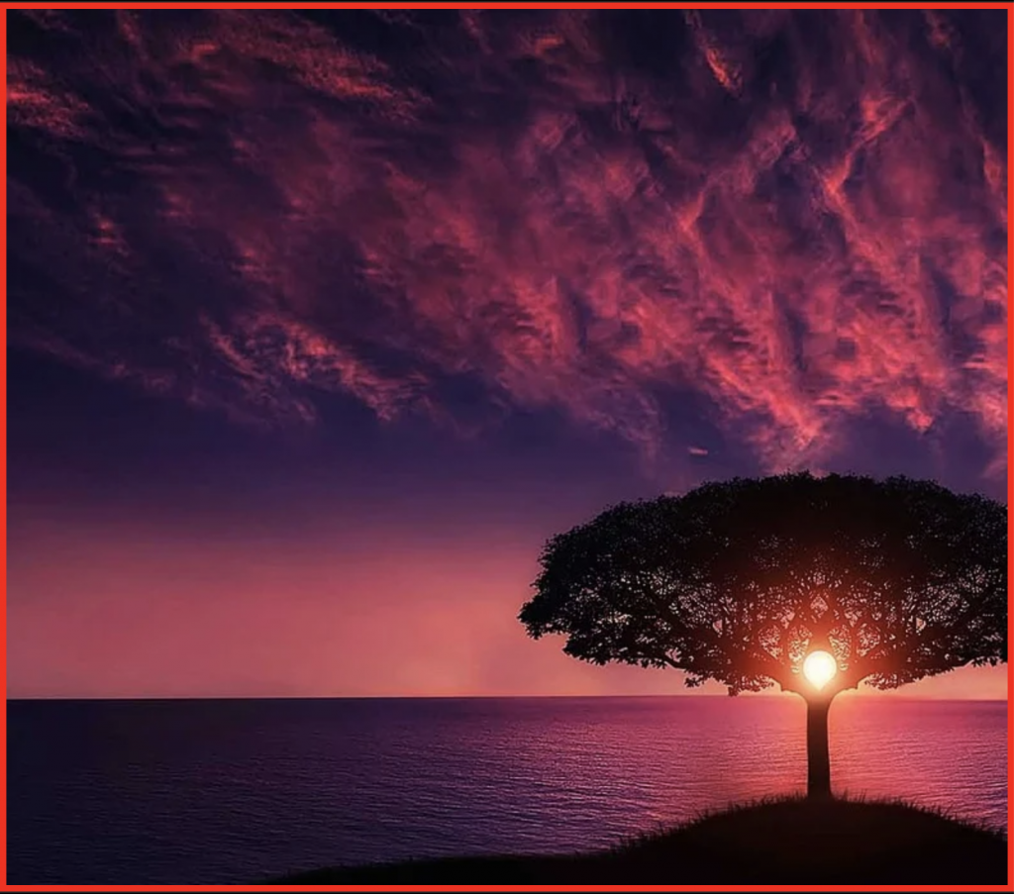
Java Script-Making it alive

Slide 15
What Java Script is
JavaScript is a versatile, text-based programming language used to create interactive and dynamic content on websites. While HTML provides the structure of a webpage and CSS is the styling that makes it look appealing, JavaScript serves as the engine/mind/brains that allows the page to react to user actions without requiring a full reload.

Slide 16


Slide 17
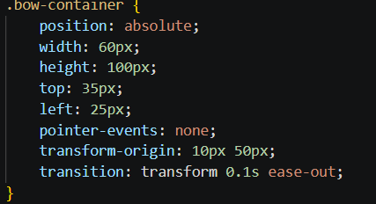

Slide 18
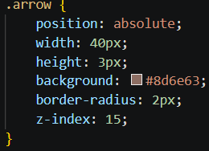

Slide 19
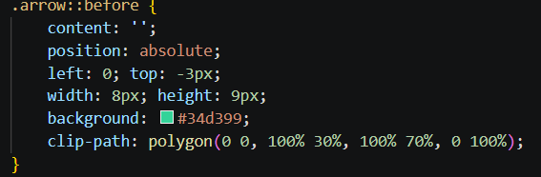

Slide 20
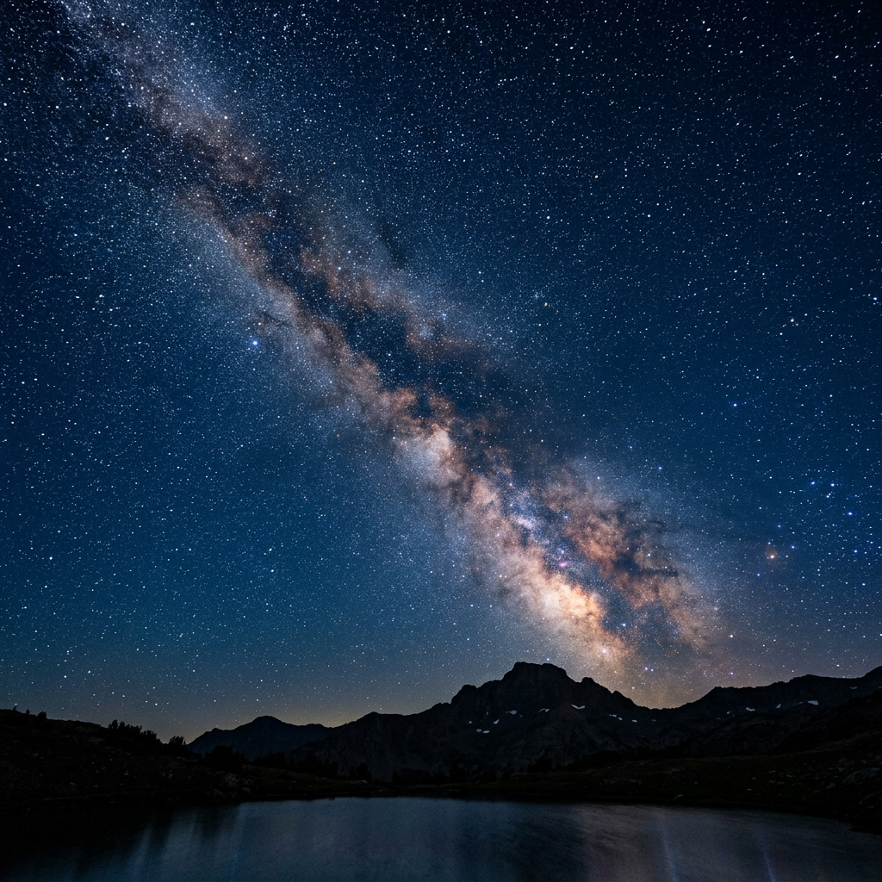
Cool Features

Slide 21
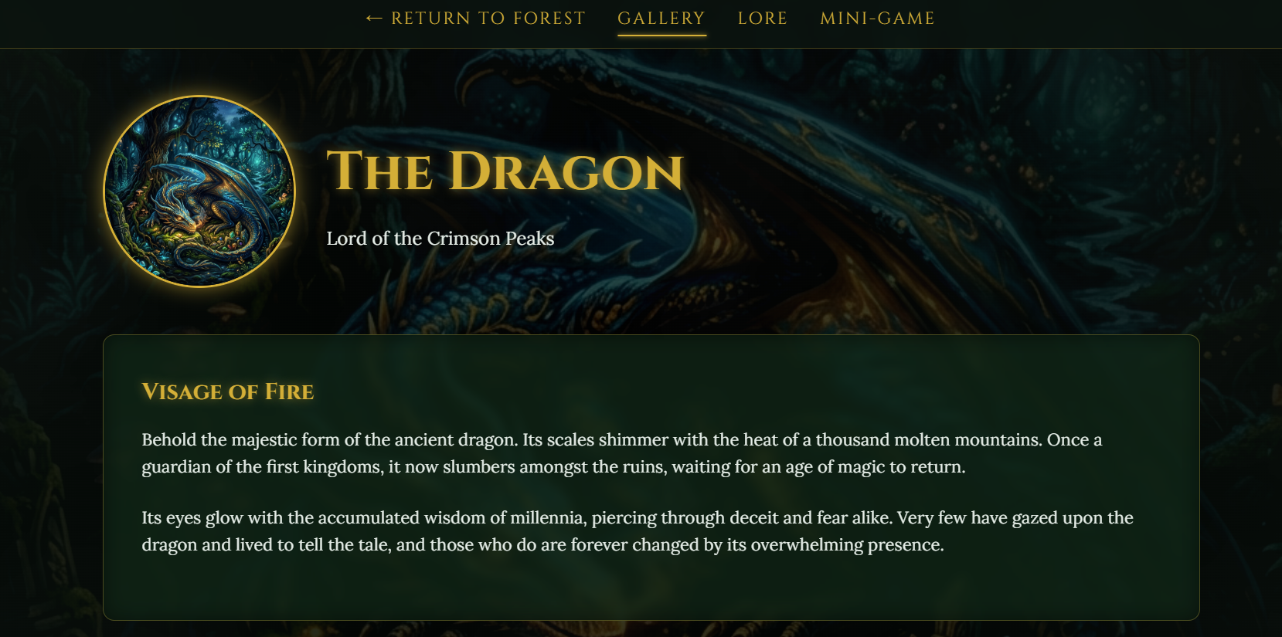
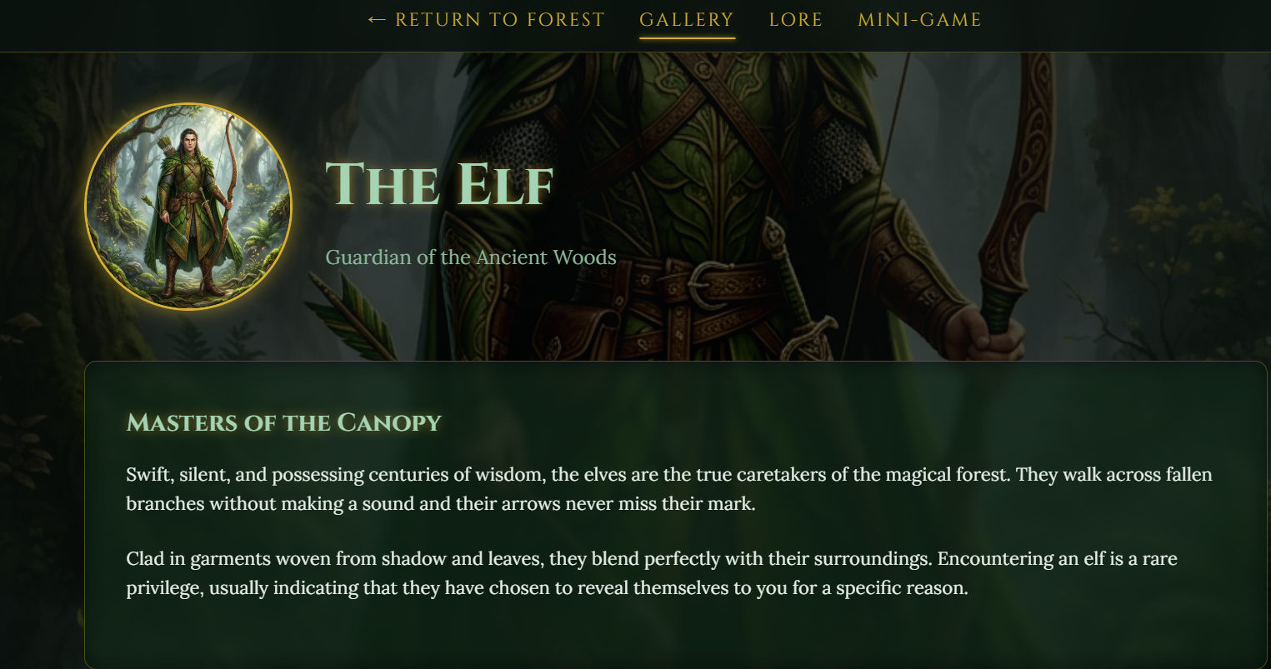
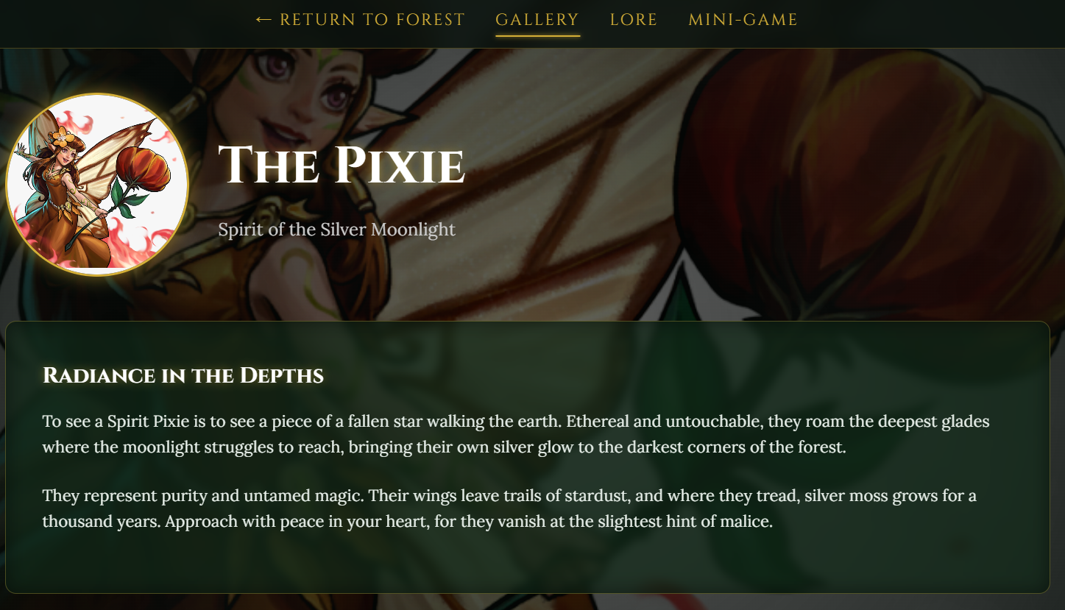
The 3 Creature Hubs
Dragon Elf Pixie

Slide 22
Challenges I faced
I struggled to think of lore for the creatures but taking inspiration from some my favorite video games and movies helped me a lot

Slide 23
What I Learned
I learned …
What HTML is (The foundation of a website)
What CSS is (The style of a website)
What JS (Java Script) is (The engine of a website)
How to make a website
Graphic Design
More about code and special keyboard features
etc.

Slide 24
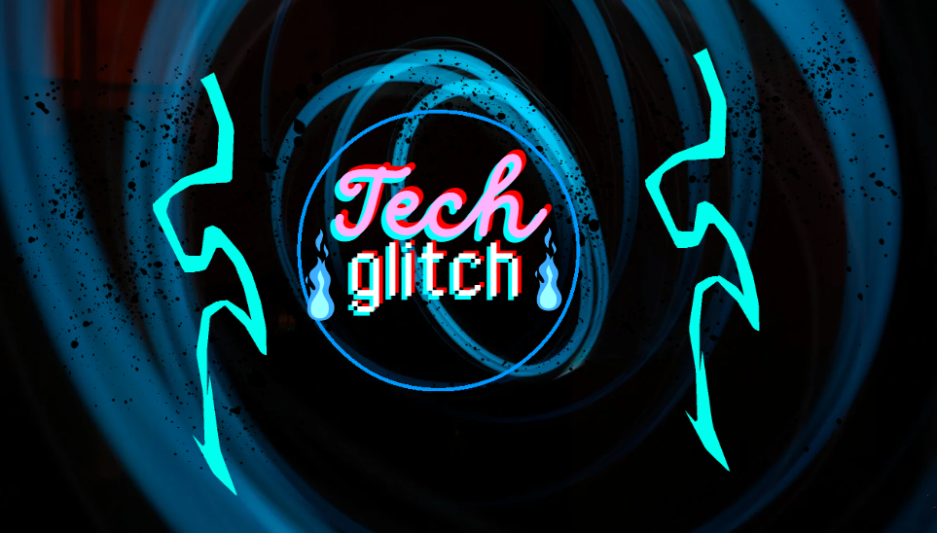
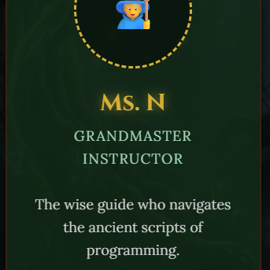
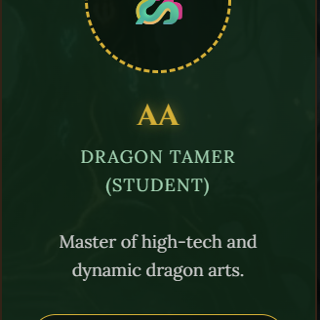
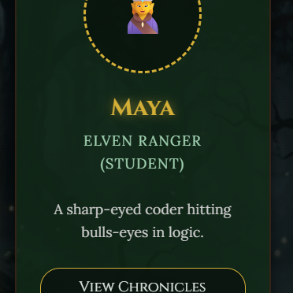
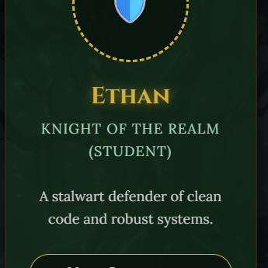
Thank You
Any Questions

